Slide 1

EShoppingZone
Created By
Anu Singh
Swayam Prakash Bhuyan
Praneender
Tanugula Akhila
Mohammed Talib
Vidyashree P
Sivaprasad nelli
Palagiri Rajiya
Prasid Satish Chinchakar
Ganesh Sivarathri
Jubeda Begum

Slide 2

Content
1.About EshoppingZone
2.Abstract
3.Detailed Requirements
4.Use Case Diagram
5.ER Diagram
6.Basic Overview with Screenshots

Slide 3
1. About EShopping Zone

Slide 4
Specifications and other Technologies used
This Project was aimed at developing a Online Shopping System using ReactJs as front-end And ASP.NET Core web api as backend.
HTML5
CSS3
TypeScript
Entity Framework
ReactJs
Swagger

Slide 5
Functionality Of Customer
1. Customers can create account through Registration.
2. login to their active account .
3. Users or Customers can browse various types of products in Catalog Page.
4. View the details of products.
5. Add products into Cart.
6. Add more items into Carts.
7. Delete items from Carts and can be Update.
9. Customers can Checkout their Order, Order details, Edit Address and Update.
10. Payment Option.
8. Order Placed.
9. Customer can view Order Summary.
10. About Our Online Shopping application.

Slide 6
2. ABSTRACT

Slide 7
Abstract
EShoppingZone is an ecommerce website, E-commerce is the activity of buying or selling of products on online services or over the Internet.
There are two roles one is merchant where he sells the products and other was the customers.
customers can create account and login to their active account. Users can browse various types of products.
This site consists of various types of products like electronics, books, apparel, and personal-care items, etc.
User can browse through the products and gradually add them to his cart. When the user completes adding the necessary items then he clicks checkout which redirects him to the checkout page where the total of the products in the cart is displayed.

Slide 8
3. Detailed Requirements

Slide 9
Detailed Requirements
User can search for a product without login and access the website.
User can login with github or with the account with which he registered in the website in order to be able to use the website.
User can add or remove products from the cart .For placing the order user has to login or create the account if he don’t have active account.
User can update the profile whenever he needs to update.
User can make wallet payment and also cash on delivery. User can view their previous orders and transactions.

Slide 10
4. Use Case Diagram

Slide 11
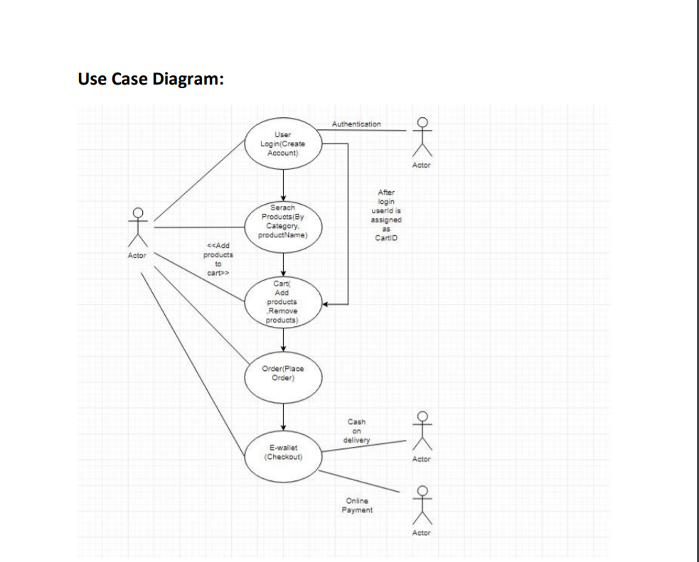

Slide 12
5.ER Diagram

Slide 13
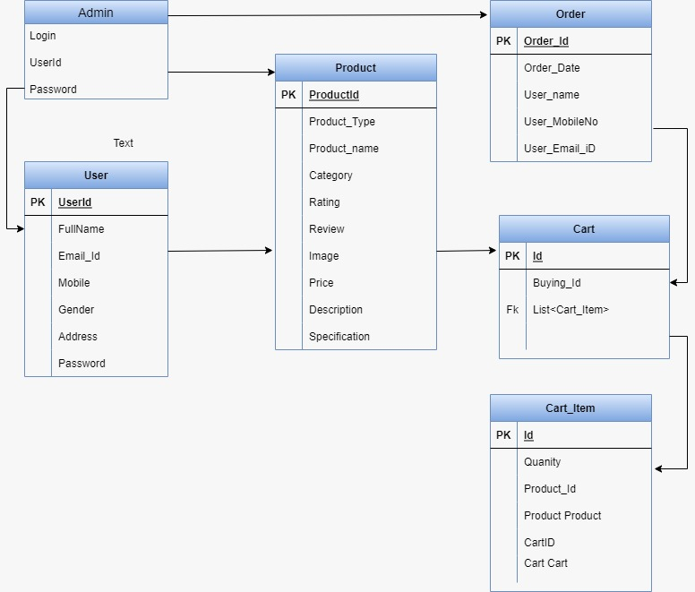
ERD Diagram

Slide 14
6. Screen Shots

Slide 15
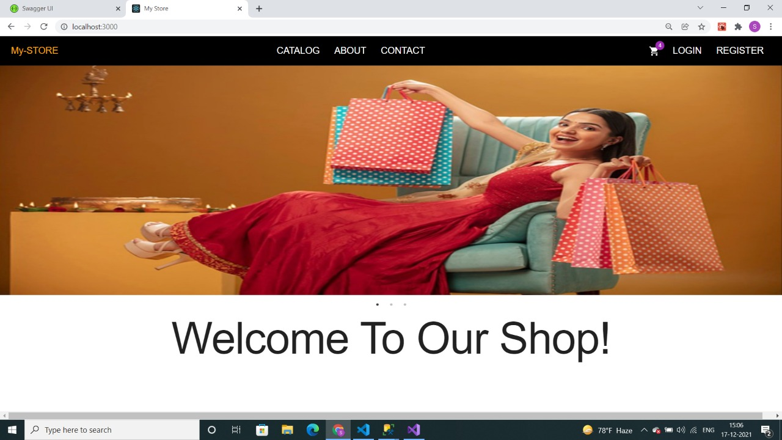
Home Page

Slide 16
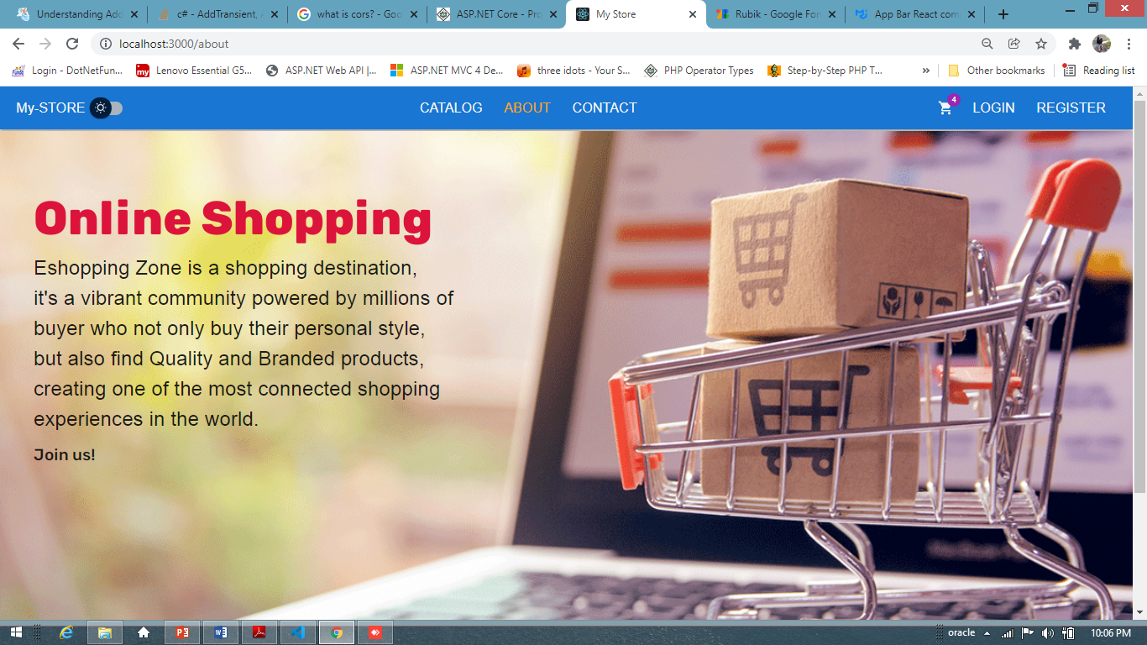
About Us Page

Slide 17
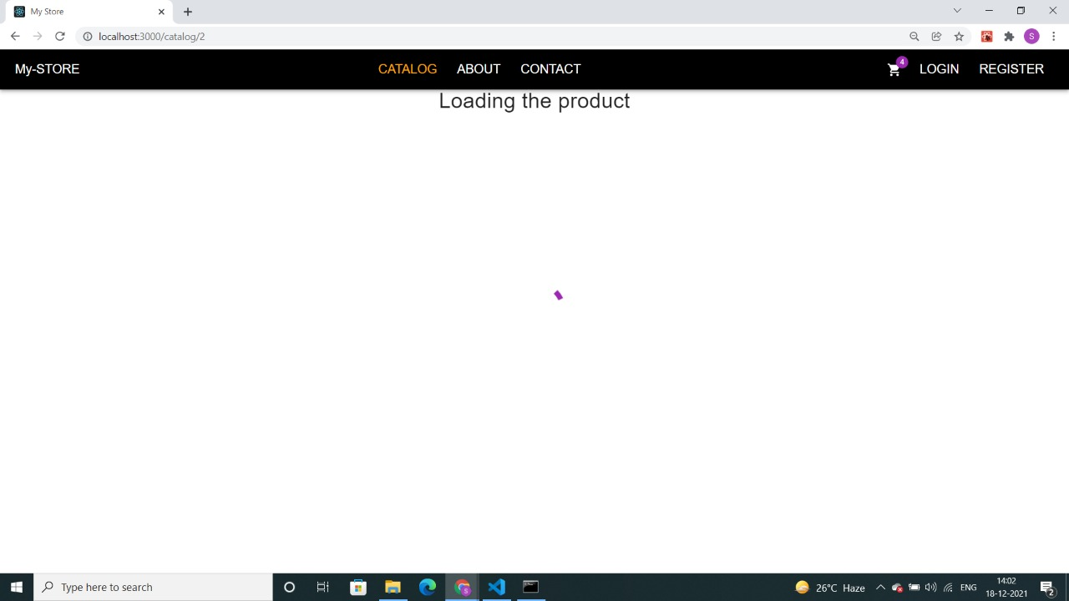
In Catalog Page Product is Loading

Slide 18
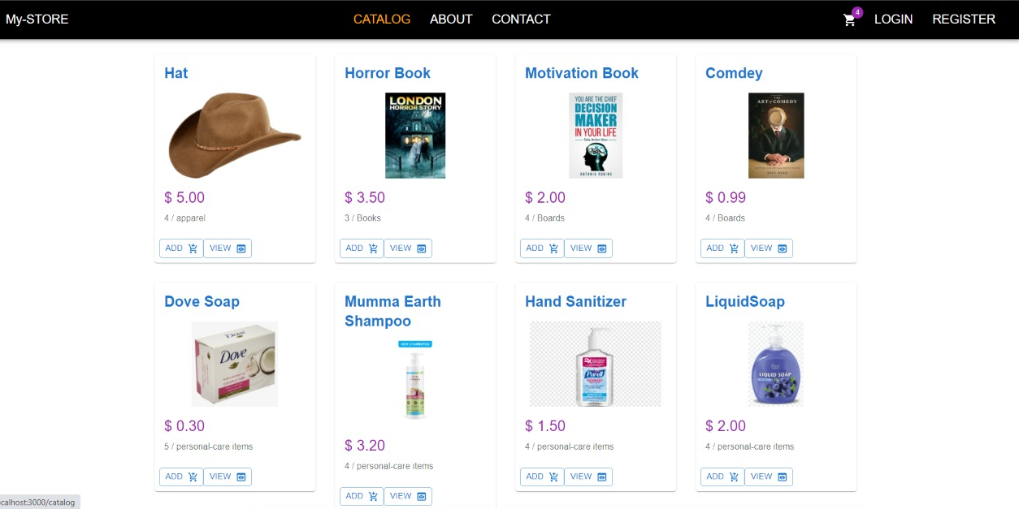
Catalog

Slide 19
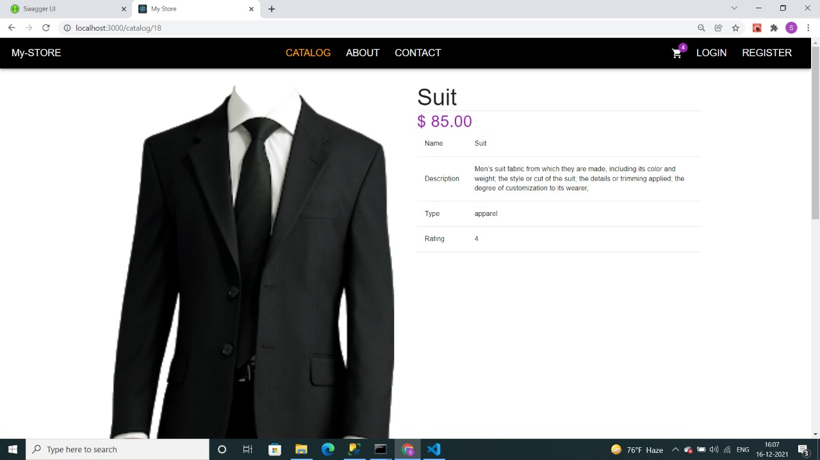
View Products

Slide 20
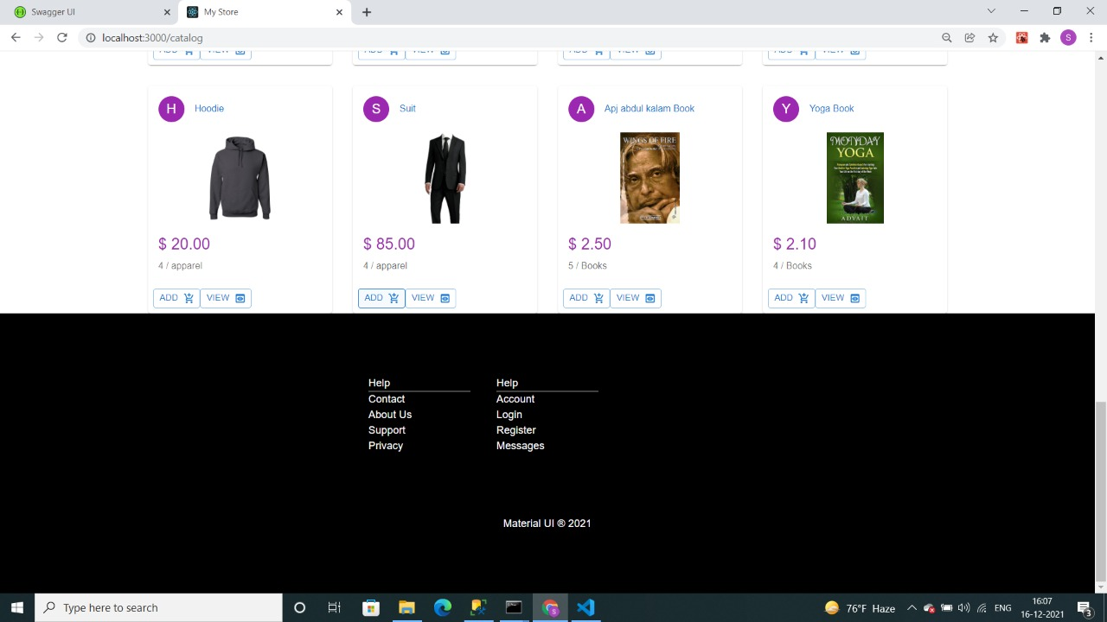
Catalog Footer

Slide 21
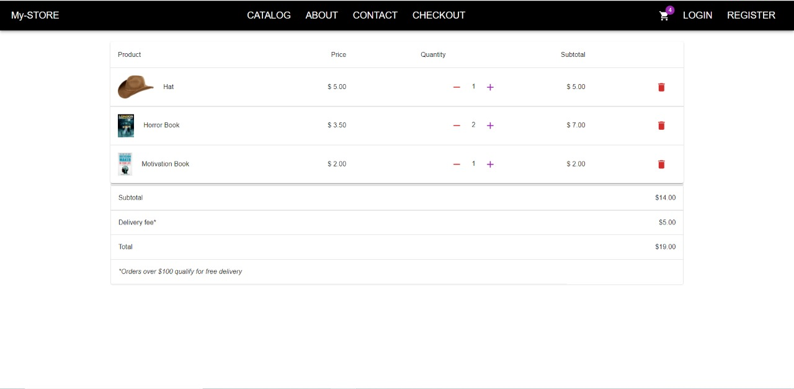
Products Add Into Cart

Slide 22
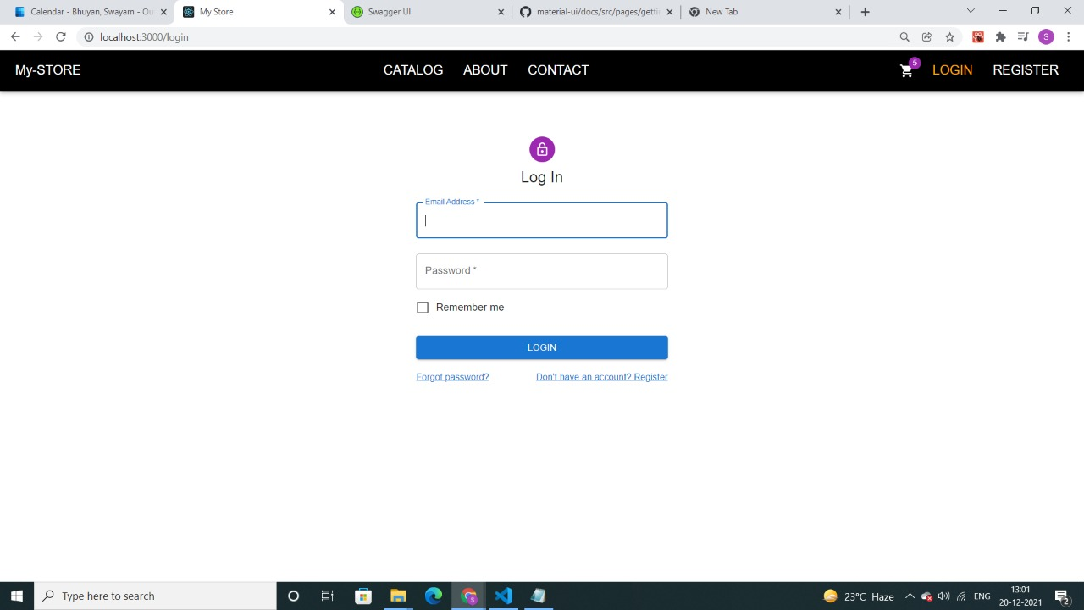
Login page

Slide 23
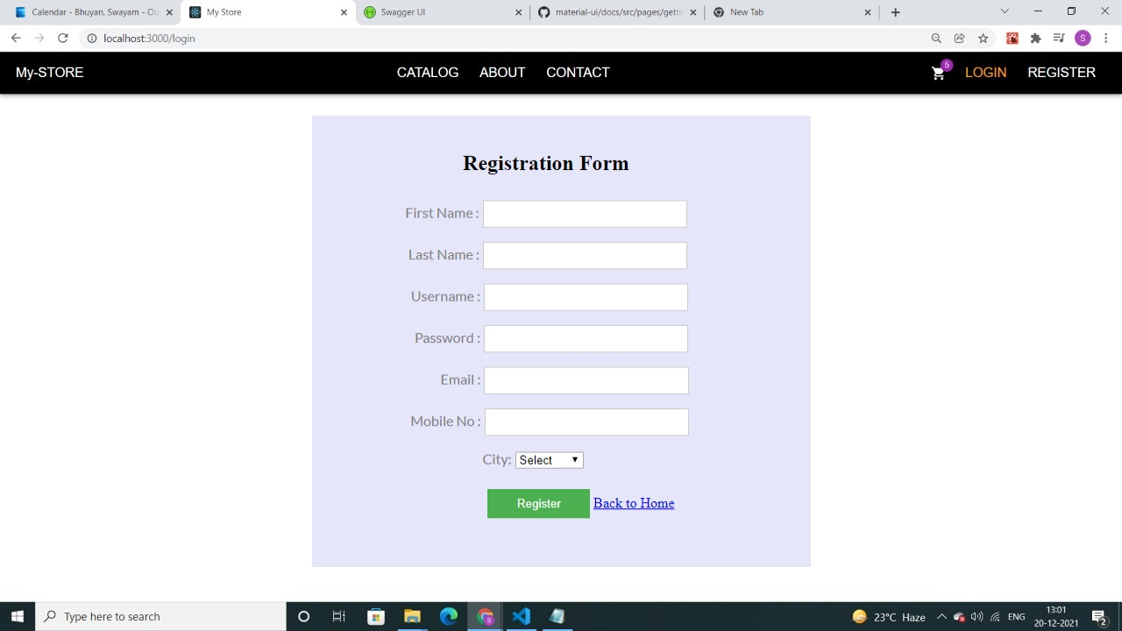
Login page

Slide 24
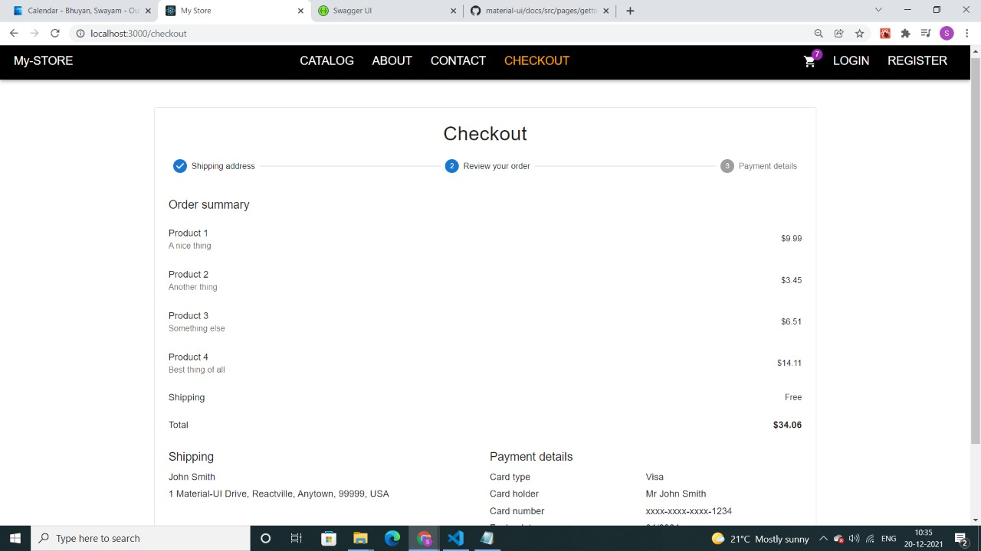
Order Summary

Slide 25
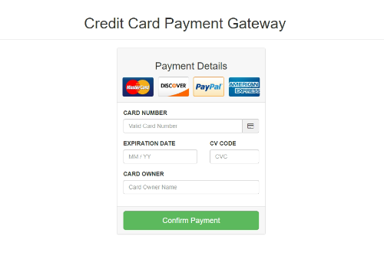
Order Summary

Slide 26
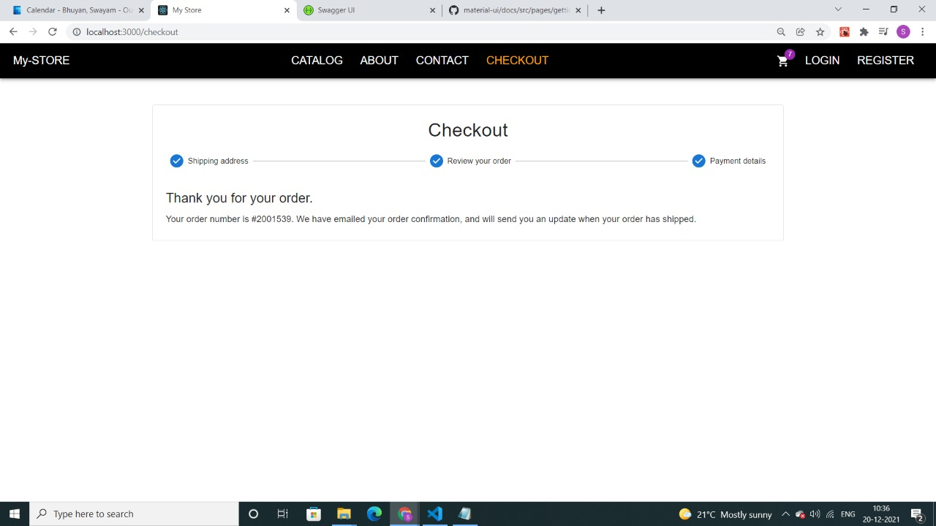
Checkout Page (Check Your Order)

Slide 27


